Slide 1
Research Excellence & Outcomes
BrAIN Workshop
Cristina Davis, Ph.D.
Associate Vice Chancellor, Interdisciplinary Research & Strategic Initiatives
Professor, Mechanical & Aerospace Engineering
August 15, 2023

Slide 2
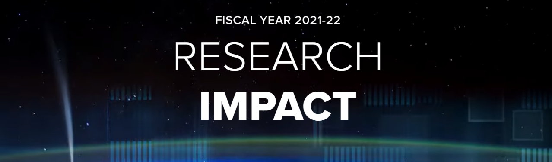

At a Glance
$1.07 billion
Research funding
13
Startups
132
Records of invention
1500+
Patents on record
$12.6 billion
Economic activity generated in CA

Slide 3
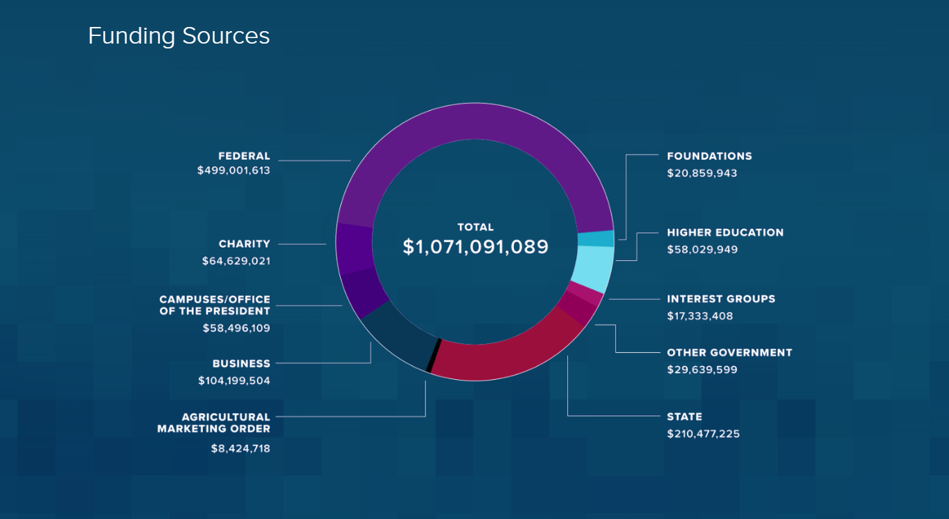

Slide 4




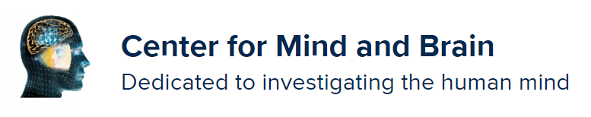






Diverse landscape of research & practice

Slide 5
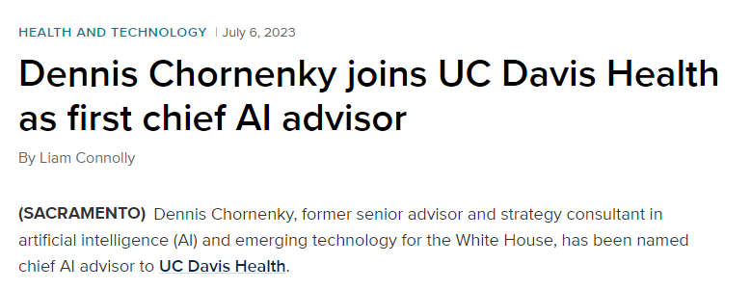
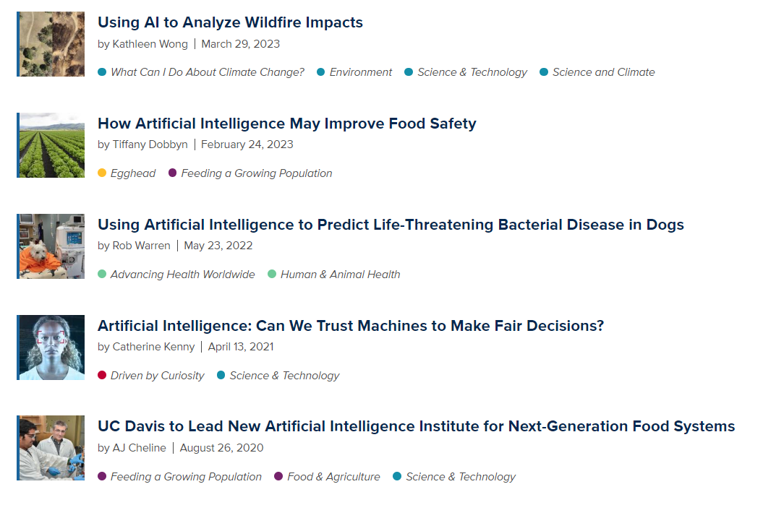
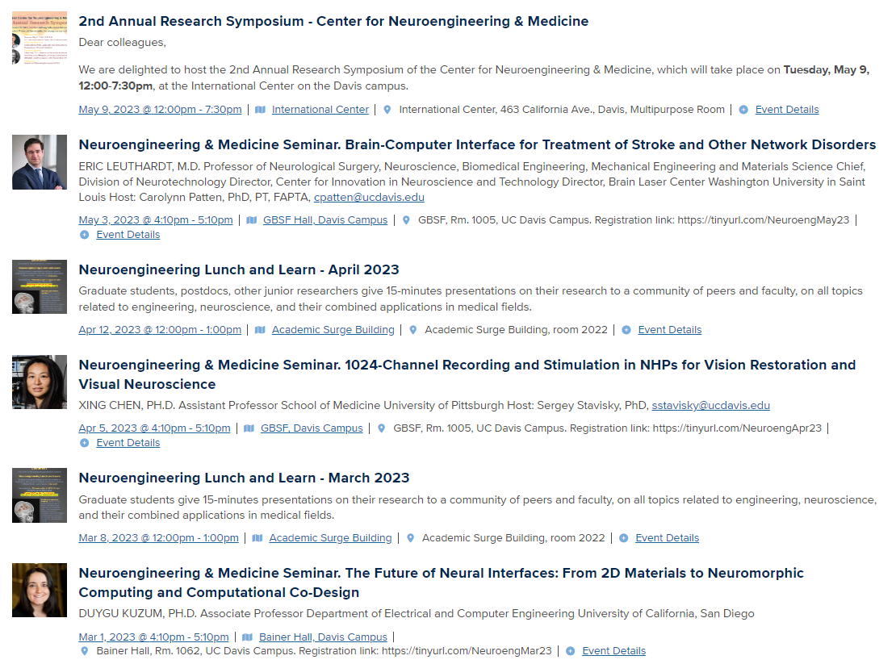


Diverse landscape of activities & outcomes
https://health.ucdavis.edu/news/headlines/meet-milo-a-powerful-machine-learning-ai-tool-from-uc-davis-health/2020/07
https://engineering.ucdavis.edu/news/artificial-intelligence-can-we-trust-machines-make-fair-decisions

